Slide 1
Rudders and Emergency Steering
This is a collection of slides from various presentations I have made.
Jim Antrim
Antrim Associates, Naval Architects www.AntrimDesign.com

Slide 2
Steering
AVOID USING YOUR EMERGENCY STEERING
Rudders are the most common problem in Hawaii races.
Check your primary rudder before you leave.
If your rudder has not been pulled for inspection in last 3 years, do it now!

Slide 3
Check Primary Rudder before you leave
Cracks/Corrosion of post at joints and at hull profile
Cracks crazing in surface of rudder indicate fatigue of blade, possible hidden weakness in post
Condition of Upper and lower bearings, gudgeons
Good structural link between hull and deck where upper and lower bearings are mounted
Pull hard on the rudder in the boatyard. What moves?

Slide 4
Wheel steered boats
Check the linkage carefully for wear, chafe points, proper adjustment, no wobble.
Have some serious sailing time on the system before you leave on long voyage to ensure that cable tension is proper and stretch is eliminated.

Slide 5
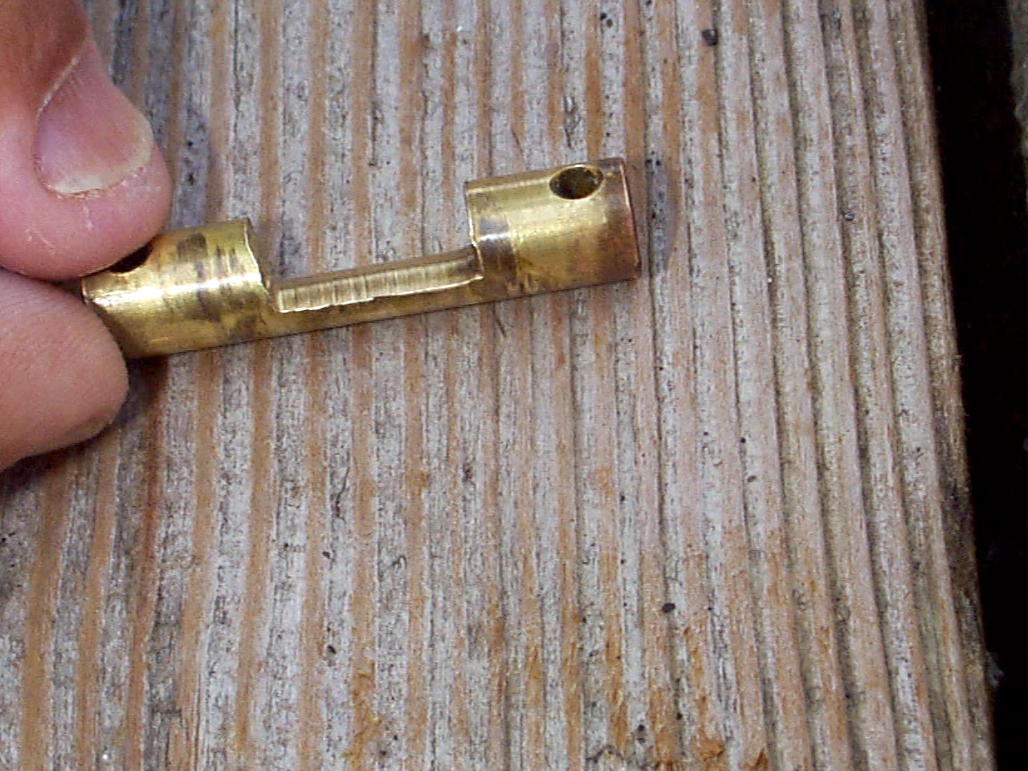
Steering sheave pin
After the sheave bearings froze

Slide 6
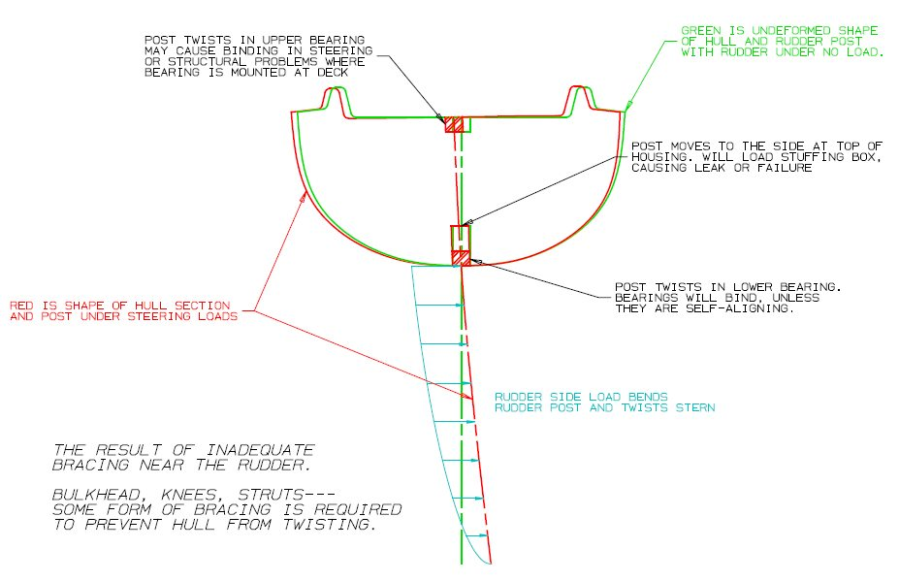
Notes:
“Rudder problems” can be a lot more than lost rudder. Bearing problems or friction, seal failure, hull distortion leading to those problems. Tiller & steering system problems.

Slide 7
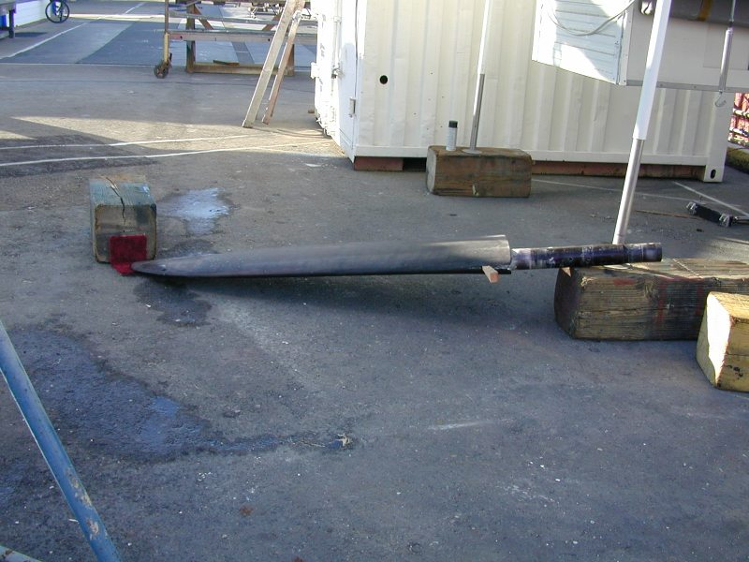
Notes:
Farr 395

Slide 8
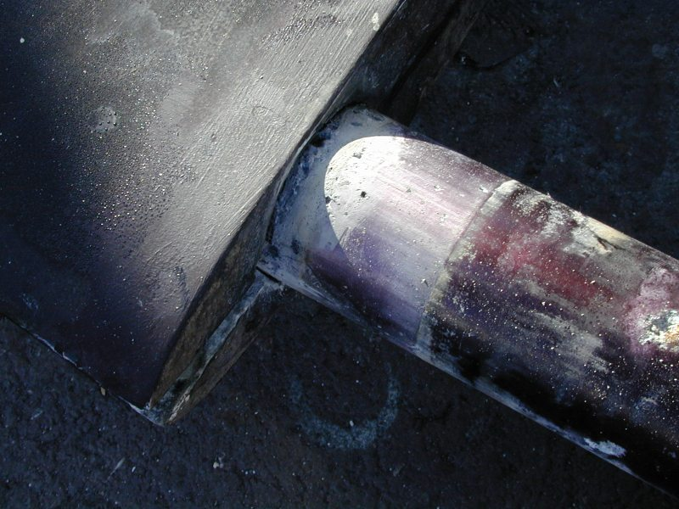
Notes:
Pitting above, under, and below bearing race

Slide 9
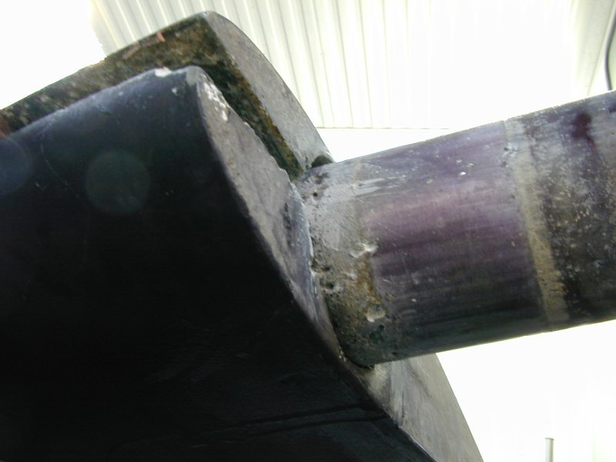
Notes:
L.E. was slightly cracked, that’s why rudder was pulled. Corrosion was a discovery.

Slide 10
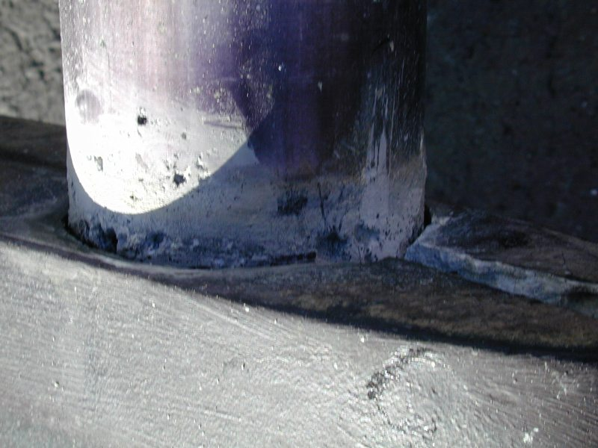
Notes:
DEEP pits just at top of blade

Slide 11
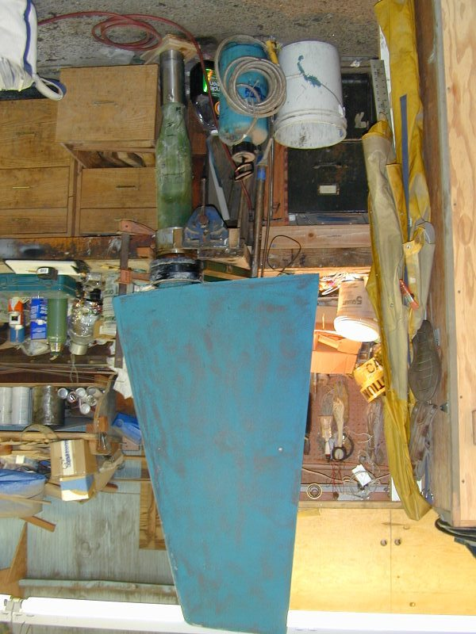
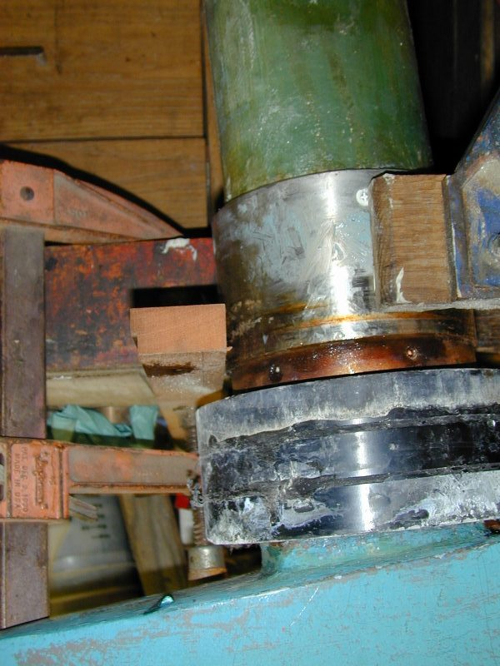
Notes:
J boat rudder, composite post, stainless sleeve, alum bearing

Slide 12
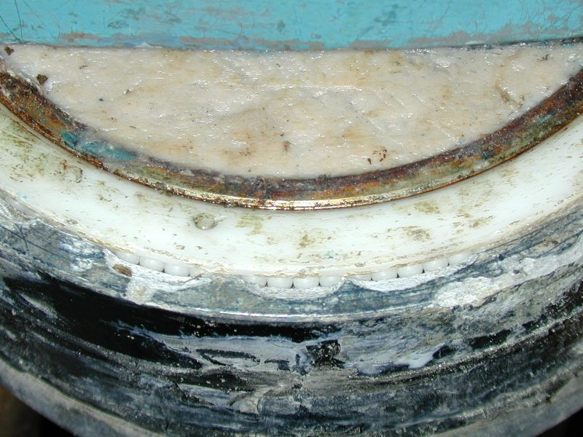
Notes:
Corrosion on edge of stainless sleeve and alum outer race.

Slide 13
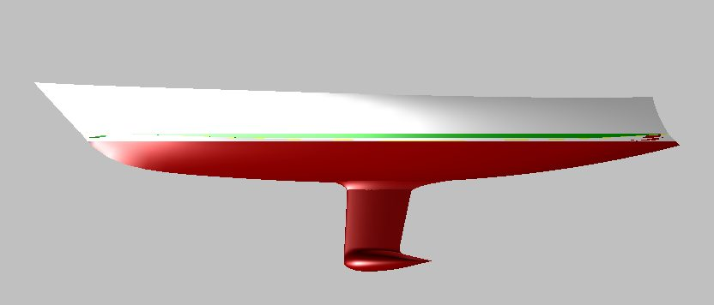
Problem: Loss of rudder
If this was an arrow, the feathers in are the wrong place.
Get the boat under control. Rig your emergency steering
A drogue will steady the boat and make it easier to mount the emergency rudder.
When underway again, balance the sail plan & helm. Drogue may help that too.

Slide 14
Emergency Steering
OSR 4.15 basics
Must have an emergency tiller
“Alternative methods of steering the yacht in any sea condition in the event of rudder loss.”
“Must be proven to work.”

Slide 15
Emergency
Rudder Links
FREE PDF file drawings of emergency rudder blade
Under ANTRIM link below
ANTRIM
http://antrimdesign.com/steering-under-emergency-rudder.html
SCANMAR SOS rudder
http://www.selfsteer.com/products/sos/index.php
Vic Maui
http://www.vicmaui.org/pdfs/VM2014%20-%20PS%20Emergency%20Steering.pdf
Paul Kamen’s emergency rudder pages
http://www.well.com/~pk/PCrudder.html
http://sfbaysss.net/resource/doc/kamen-emergency-rudder.pdf
Pineapple Sails
http://www.sailmaker.com/articles/e_rudder/
Blue Moment (Rob Macfarlane)
http://www.bluemoment.com/emergencyrudders.html
Singlehanded Sailing Society
http://sfbaysss.net/resource/doc/rudders-and-self-steering-compendium.pdf
Lots of Links
http://cruisenews.net/db/pagetemplate.php?cat_id=18
Notes:
LINKS

Slide 16
When you lose your rudder
“Out of Control” takes on a new meaning.
Emergency Rudder tests you did at home will not prepare you for this experience! Fin keel boat may spin like a top.
Deal with problem calmly, crew harnessed to boat.
Deployment of E.Rudder will be very difficult with boat swinging.
Drop sails. Raise working jib. Sheet in hard.
Deploy drogue tied to stern until E.Rudder is fitted.

Slide 17
Steering under
EMERGENCY RUDDER
Forget racing. Goal is to get to port without breaking the emergency rudder.
Reduce steering loads to avoid overloading emergency rudder and tiring the helmsmen
Moderate speed
  Steady speed makes steering easier; but avoid high speed surfing, which can overload emergency rudder.
Balance the sail plan
  Twin jibs on whisker poles if downwind.
  Eased mainsheet, or reefed main if excessive weather helm on reaching or upwind course
Drogue may be useful to make steering easier.
  Try it if Emergency Rudder is working too hard, steady course is difficult, or sailplan can’t be balanced

Slide 18
Emergency Rudder Options
Blade style (looks kind of like a real rudder)
Custom designed
Scanmar SOS rudder
Build it yourself with available guidelines
Steering Oar
Drag device
Seabrake or Delta Drogue
Chain, anchor, and/or annoying crew member hung off spinnaker pole mounted on the transom
Drogue is not the best primary emergency steering device; but is strongly recommended as potential assistance to small blades or oar, for steadying the boat while e-rudder is deployed, and as backup option if e-rudder fails.

Slide 19
Emergency Rudder Pointers
Think about a system that will be EASY TO DEPLOY with boat moving
  Daggerboard style with Cassette is good choice
BUILD IT STRONG
  Is it at least as strong as your primary rudder?
  Rudder of correct size from a smaller boat is probably not strong enough; because your boat will be faster and heavier and will generate higher loads.
Rudder serves two functions
Directional stability – Pick a course and go in a straight line
Steering – Ability to change course

Slide 20
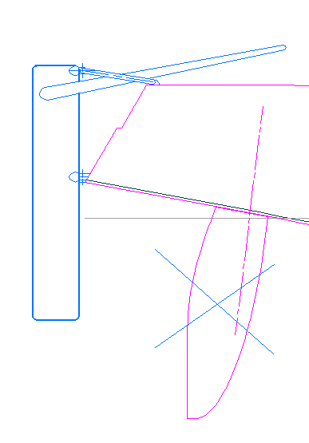
Guidelines for blade style
Emergency Rudder
Draft half of original rudder
Area half of original rudder
Thick foil to keep it strong
Rough surface finish OK – may help with fat foil

Slide 21
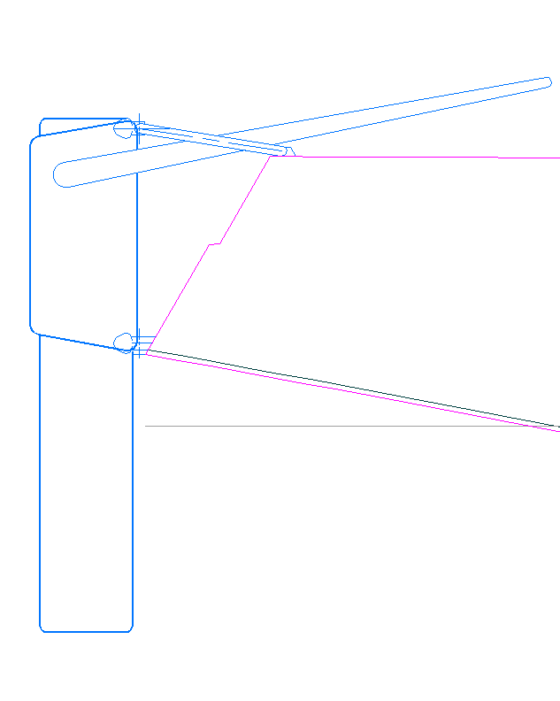
Cassette style easier to deploy
Cassette must be very strong!
Mount the cassette
(better yet have it mounted for the whole voyage.)
Slide the Blade down

Slide 22
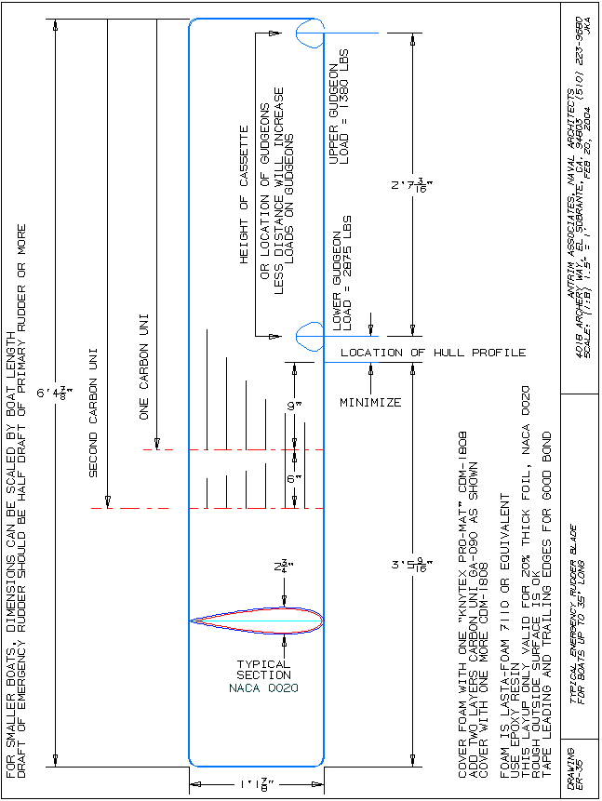
Sample free Antrim blade drawing www.AntrimDesign.com

Slide 23
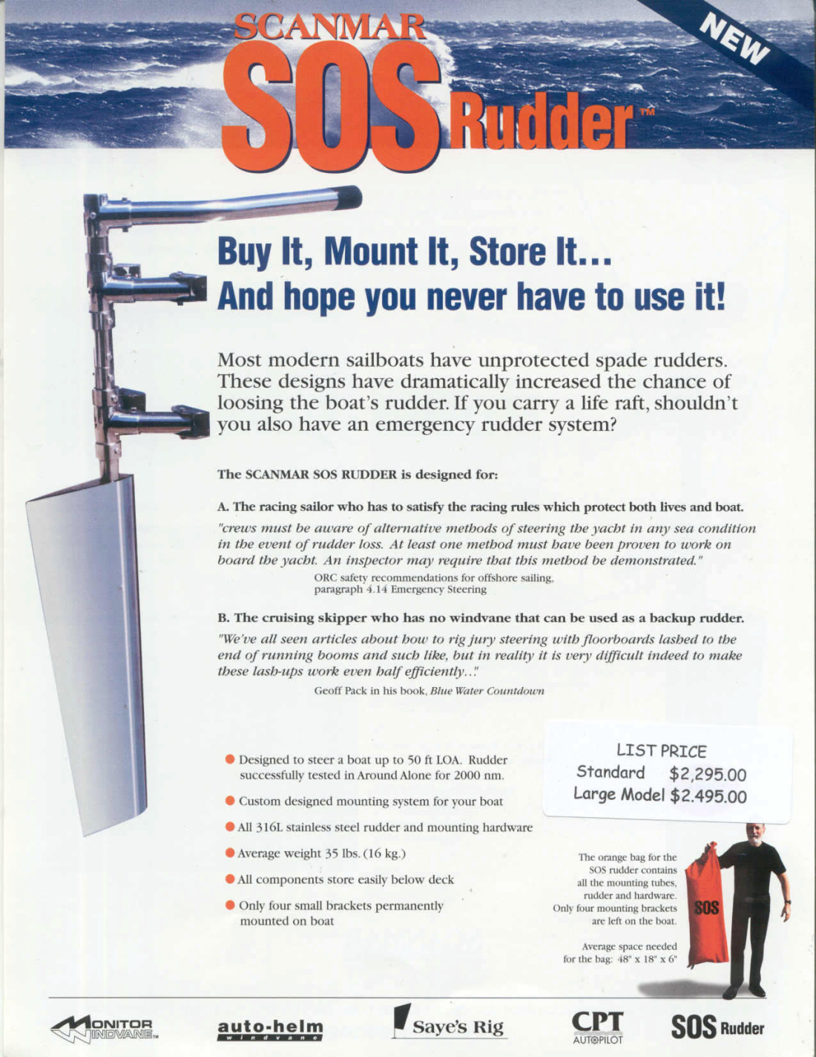
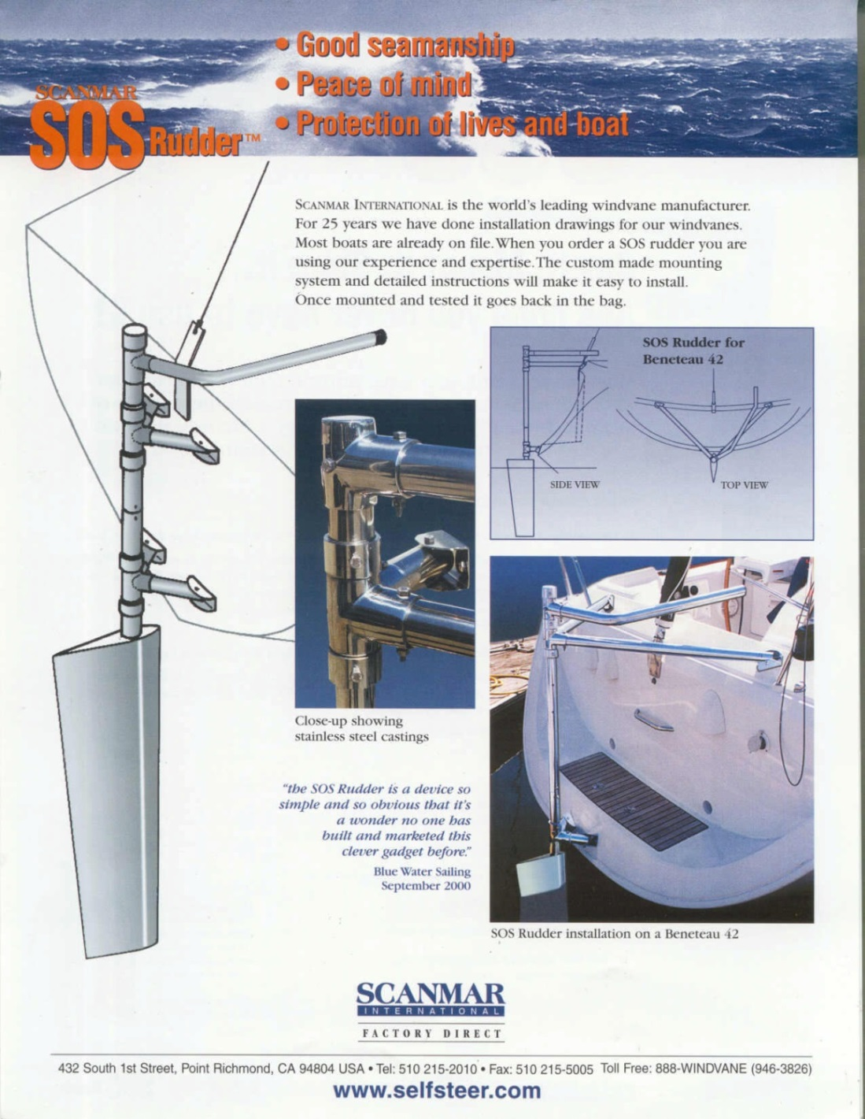
Scanmar SOS

Slide 24
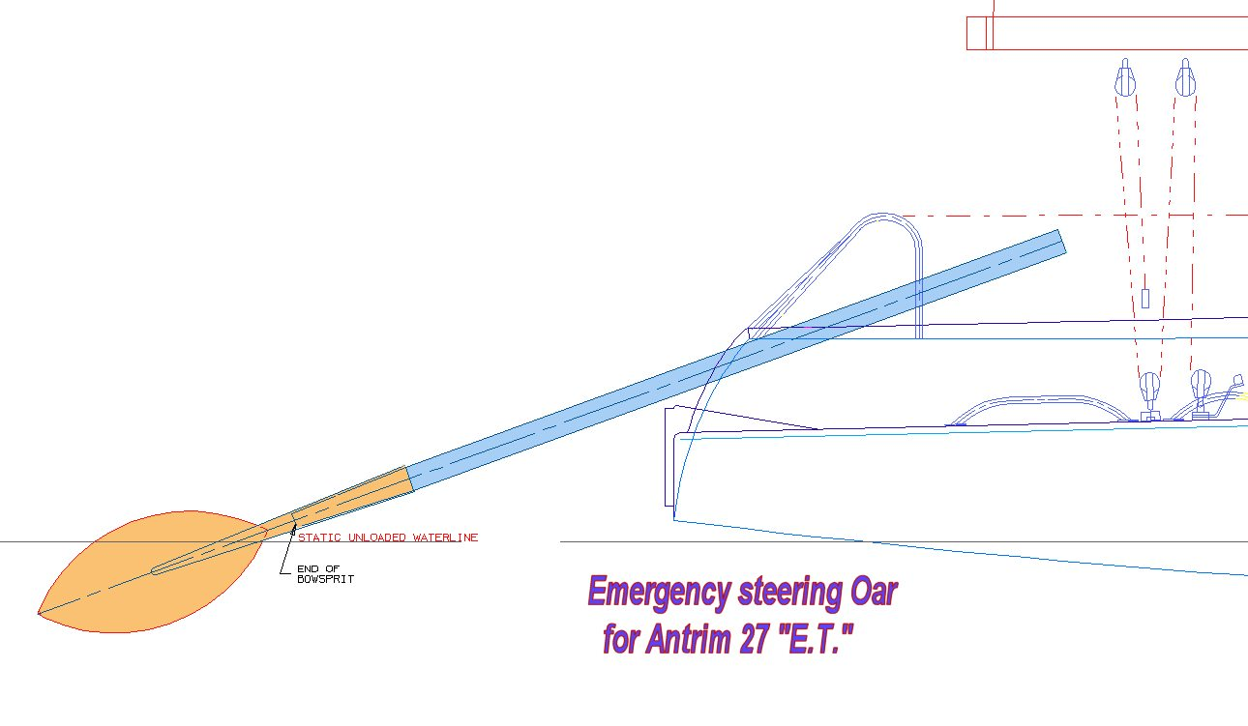
Steering Oar (viable for small, light boats only)
With open transom, pivot point is just a lashing between padeyes on opposite sides of the cockpit. No hard contact.
Spare bowsprit
Removable
blade

Slide 25
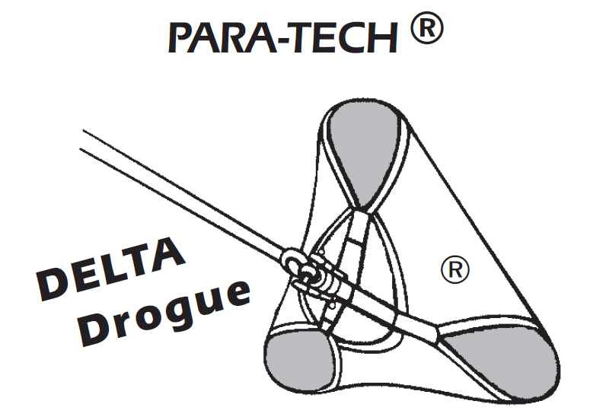
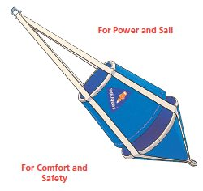
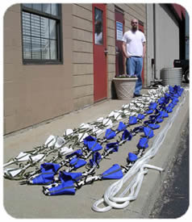
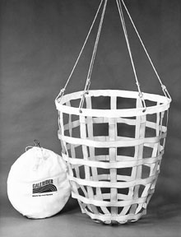
http://www.seaanchor.com/
Seabrake
Jordan series drogue
www.seabrake.com/
http://www.jordanseriesdrogue.com/
http://www.seriesdrogue.com/
http://www.hathaways.com/galerider/
http://www.paraanchor.com/
Galerider

Slide 26
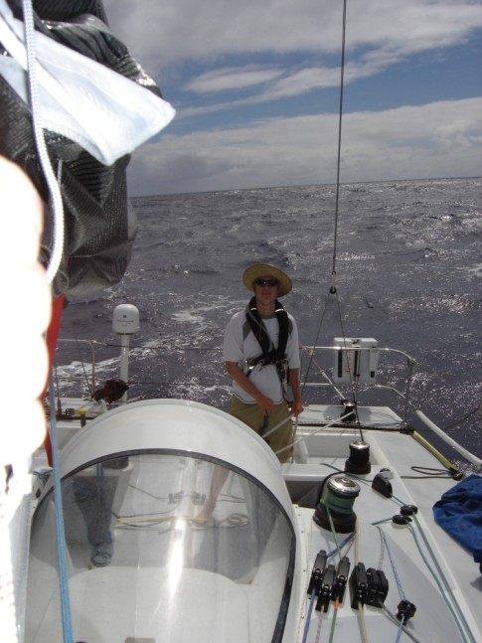
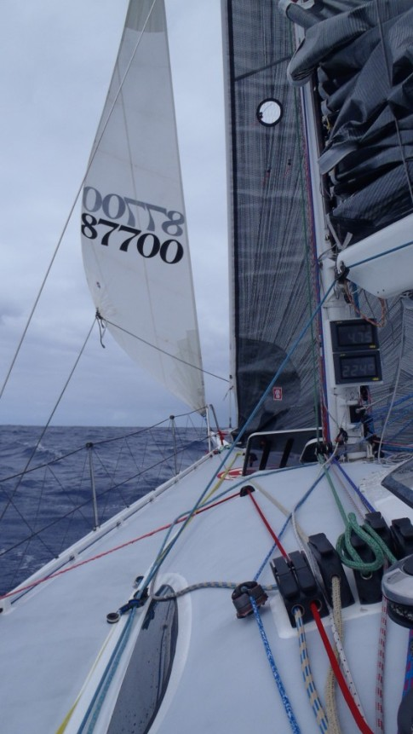
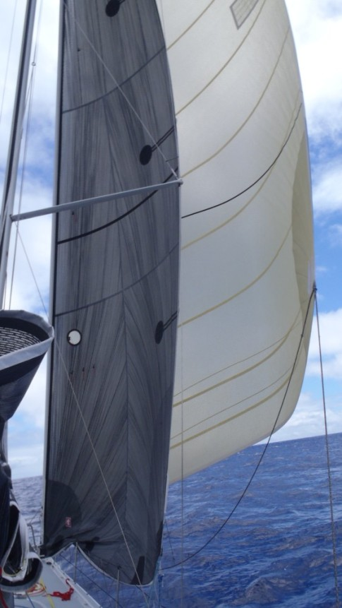
Steering with a drogue
White trail of series drogue
Wing & wing
Double headsail reaching
Steering with a bridle to the drogue.
One side of bridle is fixed. Boat is steered by trimming the length of the other bridle leg.

